Slide 1
RNA-Seq and transcriptome analysis
Radhika S. Khetani, Ph.D.
Technical Lead, User Support & Training
High Performance Biological Computing (HPCBio)
Roy J. Carver Biotechnology Center

Slide 2
RNA-Seq or Transcriptome Sequencing
RNA-Seq
It is the process of sequencing the transcriptome
Its uses include –
Differential Gene Expression
Quantitative evaluation and comparison of transcript levels
Transcriptome assembly
Building the profile of transcribed regions of the genome, a qualitative evaluation.
Can be used to help build better gene models, and verify them using the assembly
Metatranscriptomics or community transcriptome analysis
Small RNA analysis
Notes:
Various uses of RNA-Seq and technologies (illumina, EST-sanger, 454)

Slide 3
RNA-Seq or Transcriptome Sequencing
RNA-Seq
It is the process of sequencing the transcriptome
Its uses include –
Differential Gene Expression
Quantitative evaluation and comparison of transcript levels
Transcriptome assembly
Building the profile of transcribed regions of the genome, a qualitative evaluation.
Can be used to help build better gene models, and verify them using the assembly
Metatranscriptomics or community transcriptome analysis
Small RNA analysis
Notes:
Various uses of RNA-Seq and technologies (illumina, EST-sanger, 454)

Slide 4
RNA-Seq or Transcriptome Sequencing
Sequencing technologies applicable to RNA-Seq
High throughput
Illumina HiSeq 2500
Illumina Next-Seq 500
Illumina MiSeq
Illumina X Ten
“Lower” throughput
Roche 454
Low throughput
Sanger
Illumina…
Notes:
Various uses of RNA-Seq and technologies (illumina, EST-sanger, 454)

Slide 5
Outline
Getting the RNA-Seq data: from RNA -> Sequence data
Experimental and Practical considerations
Transcriptomic analysis methods and tools
Assemblies
Differential Gene Expression

Slide 6
Outline
Getting the RNA-Seq data: from RNA -> Sequence data
Experimental and Practical considerations
Transcriptomic analysis methods and tools
Assemblies
Differential Gene expression

Slide 7
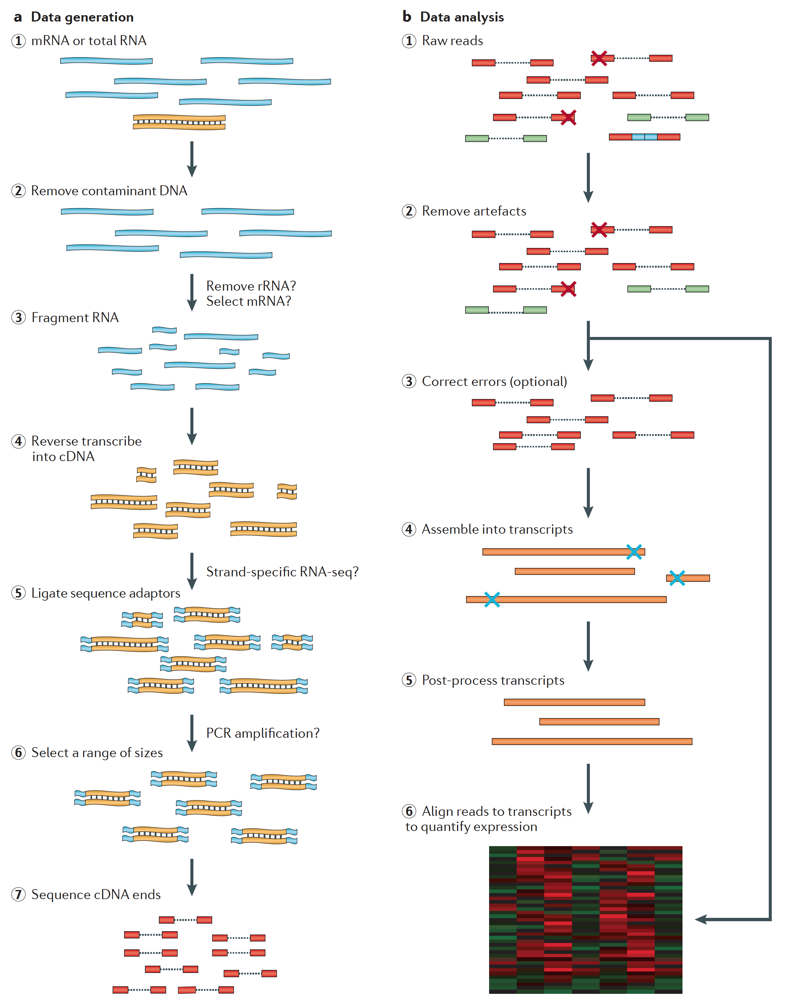
From RNA -> sequence data
Martin J.A. and Wang Z., Nat. Rev. Genet. (2011) 12:671–682

Slide 8
From RNA -> sequence data
Martin J.A. and Wang Z., Nat. Rev. Genet. (2011) 12:671–682

Slide 9
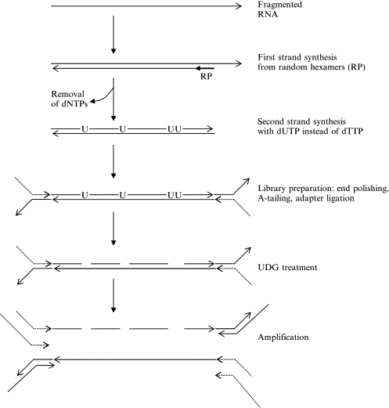
From RNA -> sequence data
Uracil DNA Glycosylase
Borodina T., Methods in Enzymology (2011) 500:79–98
Notes:
Uracil DNA Glycosylase

Slide 10
From RNA -> sequence data
Ready for sequencing
Martin J.A. and Wang Z., Nat. Rev. Genet. (2011) 12:671–682

Slide 11
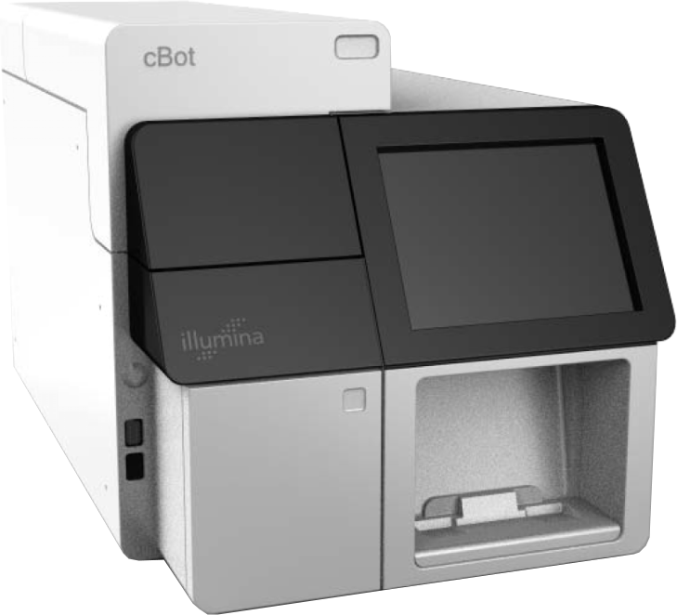
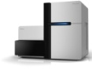
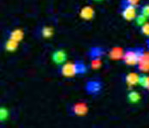
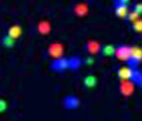
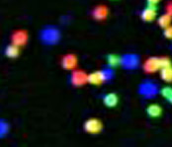
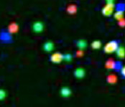
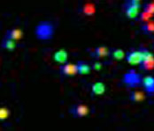

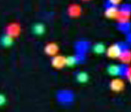
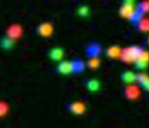
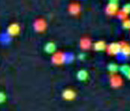
Illumina Sequencing Technology Workflow
3’
5’
DNA (0.1-5.0 μg)
A
T
C
G
C
T
T
G
A
G
C
C
A
G
A
T
G
C
A
A
T
C
G
C
C
C
G
Single molecule array
A
T
C
G
A
5’
A
Library Preparation
Cluster Growth
Sequencing
1
2
3
4
5
6
7
8
9
T G T A C G A T …
11
Alvaro Hernandez
Image Acquisition
Base Calling

Slide 12
From RNA -> sequence data
Martin J.A. and Wang Z., Nat. Rev. Genet. (2011) 12:671–682

Slide 13
Outline
Getting the RNA-Seq data: from RNA -> Sequence data
Experimental and Practical considerations
Transcriptomic analysis methods and tools
Assemblies
Differential Gene expression

Slide 14
Outline
Experimental and Practical considerations
Experimental Design
Poly(A) enrichment or ribosomal RNA depletion?
Single-end or Paired end?
Insert size for paired-end data?
Stranded or not?
How much sequencing data to collect?

Slide 15
RNA-Seq
Experimental and Practical considerations
Experimental design
Technical replicates: Illumina has low technical variation unlike microarrays, hence technical replicates are unnecessary.
Batch effects are still a problem, try and sequence everything for a given experiment at the same time (different flow cells are usually okay). If you are preparing the libraries, try to be consistent and make them simultaneously
Biological replicates, are absolutely essential for your experiment to have any statistical power. Have at least 3.
Notes:
Experimental design – technical reps not needed, biological reps for DEG (no pooling!), but tissue diversity for assembly
http://encodeproject.org/ENCODE/protocols/dataStandards/RNA_standards_v1_2011_May.pdf
http://encodeproject.org/ENCODE/experiment_guidelines.html

Slide 16
RNA-Seq
Experimental and Practical considerations
Experimental design
For transcriptome assembly, RNA can be pooled from various sources to ensure the most robust transcriptome. Pooling can also be done after sequencing, prior to entering the data into an assembler.
For differential gene expression, pooling RNA from multiple biological replicates is usually not advisable; only do so if you have multiple pools from each experimental condition.
Notes:
Experimental design – technical reps not needed, biological reps for DEG (no pooling!), but tissue diversity for assembly
http://encodeproject.org/ENCODE/protocols/dataStandards/RNA_standards_v1_2011_May.pdf
http://encodeproject.org/ENCODE/experiment_guidelines.html

Slide 17
RNA-Seq
Experimental and Practical considerations
Poly(A) enrichment or ribosomal RNA depletion?
Depends on which RNA entities you are interested in…
For transcriptome assembly, it is best to remove all ribosomal RNA (and maybe enrich for only polyA+ transcripts)
For differential gene expression, it is best to enrich for Poly(A)
EXCEPTION – If you are aiming to obtain information about long non-coding RNAs
For metatranscriptomics, e.g. gut microbiome, it is best to remove all the host materials. Remove most of the rRNA by molecular methods prior to sequencing, and remove host mRNA by computational methods post-sequencing

Slide 18
RNA-Seq
Experimental and Practical considerations
Single-end or Paired end?
Depends on what your goals are, paired-end reads are thought to be better for reads that map to multiple locations, for assemblies and for isoform differentiation.
Single-end read
Read1
ATGTTCCATAAGC…
Paired-end reads
Read1
ATGTTCCATAAGC…
Read2
CCGTAATGGCATG…

Slide 19
RNA-Seq
Experimental and Practical considerations
Single-end or Paired end?
Depends on what your goals are, paired-end reads are thought to be better for reads that map to multiple locations, for assemblies and for isoform differentiation.
For transcriptome assembly, paired-end is the best way to go.
For differential gene expression, single-end and paired-end are both okay, which one you pick depends on-
The abundance of paralogous genes in your system of interest
How you will be doing your analysis, and if your downstream methods are able to take advantage of the extra data you are collecting
Your budget, paired-end data is usually 2x more expensive
For metatranscriptomics, paired-end is better to allow you to differentiate between orthologous genes from different species.

Slide 20
RNA-Seq
Experimental and Practical considerations
Stranded?
Most kits for RNA-Seq library preparation have moved to producing stranded libraries. This means that with some amount of certainty you can identify which strand of DNA the RNA was transcribed from. Strandedness is advisable for all applications.
3 types of libraries –
Unstranded – you have no idea which strand of DNA was used to transcribe the reads, the information is lost during the cDNA library prep stage.
Reverse – reads were transcribed from the strand with complementary sequence. dUTP incorporation during second-strand synthesis is a commonly used library prep method that yields “reverse” data.
Forward – reads were transcribed from the strand that has a sequence identical to the reads.

Slide 21
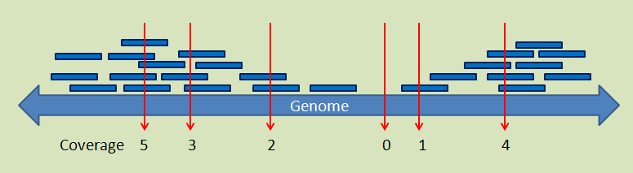
RNA-Seq
Experimental and Practical considerations
How much sequencing data to collect?
It depends heavily on the size of the transcriptome of interest, and in the case of metatranscriptomics, the diversity you expect in the community you are sequencing.
The factor used to estimate the depth of sequencing for genomes is coverage - how many times do the total nucleotides you sequenced “cover” the genome.

Slide 22
RNA-Seq
Experimental and Practical considerations
How much sequencing data to collect?
It depends heavily on the size of the transcriptome of interest, and in the case of metatranscriptomics, the diversity you expect in the community you are sequencing.
The factor used to estimate the depth of sequencing for genomes is coverage - how many times do the total nucleotides you sequenced “cover” the genome.
But, this is not a good measure for RNA-Seq, since transcription does not occur from the whole genome (it’s controversial what % is transcribed), and only ~2% of the human genome transcribes protein-coding RNA.
You can use a rough estimate of nucleotide coverage if you only consider the protein-coding areas (depending upon exactly what you chose to sequence). But this is only a very crude, inaccurate measure, since some mRNAs will be much more abundant than others, and some genes are much longer than others!
For human samples ~30 – 50 million reads per sample is recommended.

Slide 23
RNA-Seq
Experimental and Practical considerations
How much sequencing data to collect?
It depends heavily on the size of the transcriptome of interest, and in the case of metatranscriptomics, the diversity you expect in the community you are sequencing.
The ENCODE project has some very in-depth guidelines on how to make this choice for different types of projects at http://encodeproject.org/ENCODE/experiment_guidelines.html

Slide 24
File formats
A brief note
Sequence formats
FASTA
FASTQ
Alignment formats
SAM/BAM
Feature formats
GFF
GTF

Slide 25
File formats
FASTA
>unique_sequence_ID
ATTCATTAAAGCAGTTTATTGGCTTAATGTACATCAGTGAAATCATAAATGCTAAAAATTTATGATAAAAGAATAC
>Group10 gi|323388978|ref|NC_007079.3| Amel_4.5, whole genome shotgun sequence
TAATTTATATATCTATTTTTTTTATTAAAAAATTTATATTTTTGTTAAAATTTTATTTGATTAGAAATAT
TTTTACTATTGTTCATTAATCGTTAATTAAAGATAGCACAGCACATGTAAGAATTCTAGGTCATGCGAAA
TTAAAAATTAAAAATATTCATATTTCTATAATAATTAAATTATTGTTTTAATTTAAGTAAAAAAATTTCT
AAGAAATCAAAAATTTGTTGTAATATTGAAACAAAATTTTGTTGTCTGCTTTTTATAGTAACTAATAAAT
ATTTAATAAAAAATTACTTTATTTAATATTTTATAATAAATCAAATTGTCCAATTTGAAATTTATTTTAT
CACTAAAAATATCTTTATTATAGTCAATATTTTTTGTTAGGTTTAAATAATTGTTAAAATTAGAAAATGA
TCGATATTTTCAAATAGTACGTTTAACTAATACTTAAGTGAAAGGTAAAGCGGTTATTTAAAATATTGAT
TTATAATATTCGTGACATAATATATTTATAAATAGATTATATATATATATATACATCAAAATATTATACG
AGAACTAGAAAATATTACAGATGCAAAATAAATTAAATTTTGTAAATGTTACAGAATTAAAAATCGAAGT

Slide 26
File formats
FASTQ
@unique_sequence_ID
ATTCATTAAAGCAGTTTATTGGCTTAATGTACATCAGTGAAATCATAAATGCTAAAAATTTATGATAAAAGAATAC
+
=-(DD--DDD/DD5:*1B3&)-B6+8@+1(DDB:DD07/DB&3((+:?=8*D+DDD+B)*)B.8CDBDD4DDD@@D
DNA sequence with quality metadata
Variants you’ll encounter –> Sanger, Illumina - Sanger is most common
May be ‘raw’ data (straight from sequencing pipeline) or processed (trimmed)
The header line, starts with ‘@’,followed directly by an ID and an optional description (separated by a space)
Can hold 100’s of millions of records
Files can be very large - 100’s of GB apiece

Slide 27
File formats
GFF3
Tab-delimited file to store genomic features, e.g. genomic intervals of genes and gene structure
Meant to be unified replacement for GFF/GTF (includes specification)
All but UCSC have started using this (UCSC prefers their own internal formats)
Chr1 amel_OGSv3.1 gene 204921 223005 . + . ID=GB42165
Chr1 amel_OGSv3.1 mRNA 204921 223005 . + . ID=GB42165-RA;Parent=GB42165
Chr1 amel_OGSv3.1 3’UTR 222859 223005 . + . Parent=GB42165-RA
Chr1 amel_OGSv3.1 exon 204921 205070 . + . Parent=GB42165-RA
Chr1 amel_OGSv3.1 exon 222772 223005 . + . Parent=GB42165-RA
Source
End location
Strand
Attributes (hierarchy)
Chromosome ID
Start location
Gene feature
Phase
Score (user defined)

Slide 28
File formats
GTF
Evolved from Sanger Centre GFF (gene feature format) originally, but repeatedly modified
Differences in representation of information make it distinct from GFF
AB000381 Twinscan CDS 380 401 . + 0 gene_id "001"; transcript_id "001.1";
AB000381 Twinscan CDS 501 650 . + 2 gene_id "001"; transcript_id "001.1";
AB000381 Twinscan CDS 700 707 . + 2 gene_id "001"; transcript_id "001.1";
AB000381 Twinscan start_codon 380 382 . + 0 gene_id "001"; transcript_id "001.1";
AB000381 Twinscan stop_codon 708 710 . + 0 gene_id "001"; transcript_id "001.1";
Source
End location
Strand
Attributes (some hierarchy)
Chromosome ID
Start location
Reading frame
Gene feature
Score (user defined)

Slide 29
File formats
GTF vs GFF3
GFF3 – Gene feature format
GTF – Gene transfer format
Always check which of the two formats is accepted by your application of choice, sometimes they cannot be swapped
Chr1 amel_OGSv3.1 gene 204921 223005 . + . ID=GB42165
Chr1 amel_OGSv3.1 mRNA 204921 223005 . + . ID=GB42165-RA;Parent=GB42165
Chr1 amel_OGSv3.1 3’UTR 222859 223005 . + . Parent=GB42165-RA
Chr1 amel_OGSv3.1 exon 204921 205070 . + . Parent=GB42165-RA
Chr1 amel_OGSv3.1 exon 222772 223005 . + . Parent=GB42165-RA
AB000381 Twinscan CDS 380 401 . + 0 gene_id "001"; transcript_id "001.1";
AB000381 Twinscan CDS 501 650 . + 2 gene_id "001"; transcript_id "001.1";
AB000381 Twinscan CDS 700 707 . + 2 gene_id "001"; transcript_id "001.1";
AB000381 Twinscan start_codon 380 382 . + 0 gene_id "001"; transcript_id "001.1";
AB000381 Twinscan stop_codon 708 710 . + 0 gene_id "001"; transcript_id "001.1";

Slide 30
File formats
SAM
SAM – Sequence Alignment/Map format
SAM file format stores alignment information
Plain text
Specification: http://samtools.sourceforge.net/SAM1.pdf
Contains FASTQ reads, quality information, meta data, alignment information, etc.
Files can be very large: Many 100’s of GB or more
Normally converted into BAM to save space (and text format is mostly useless for downstream analyses)

Slide 31
File formats
BAM
BAM – BGZF compressed SAM format
Compressed/binary version of SAM and is not human readable. Uses a specialize compression algorithm optimized for indexing and record retrieval
Makes the alignment information easily accessible to downstream applications (large genome file not necessary)
Relatively simple format makes it easy to extract specific features, e.g. genomic locations
Files are typically very large: ~ 1/5 of SAM, but still very large

Slide 32
Outline
Transcriptomic analysis methods and tools
Transcriptome Analysis; aspects common to both assembly and differential gene expression
Quality checks
Data alignment
Assembly
Differential Gene Expression
Choosing a method, the considerations…
Final thoughts and observations

Slide 33
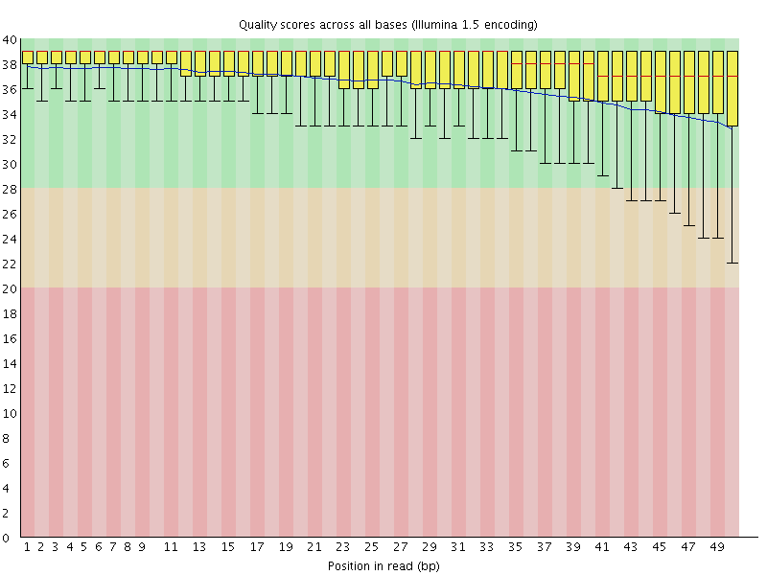
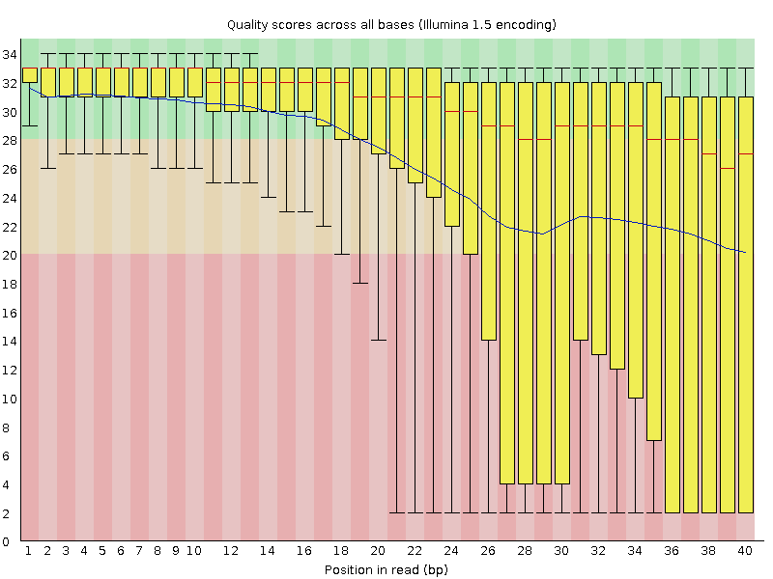
Transcriptome Analysis
Methods and Tools
Quality checks
How does my newly obtained data look?
Check for overall data quality. FastQC is a great tool that enables the quality assessment.
Good quality!
Poor quality!

Slide 34
Transcriptome Analysis
Methods and Tools
Quality checks
How does my newly obtained data look?
Check for overall data quality. FastQC is a great tool that enables the quality assessment.
In addition to the quality of each sequenced base, it will give you an idea of
Presence of, and abundance of contaminating sequences.
Average read length
GC content
NOTE – FastQC is good, but it is very strict and will not hesitate to call your dataset bad on one of the many metrics it tests the raw data for. Use logic and read the explanation for why and if it is acceptable.

Slide 35
Transcriptome Analysis
Methods and Tools
Quality checks
What do I do when FastQC calls my data poor?
Poor quality at the ends can be remedied by using “quality trimmers” like trimmomatic, fastx-toolkit, etc.
Left-over adapter sequences in the reads can be remedied by using “adapter trimmers” like trimmomatic. Always trim adapters as a matter of routine (trimmomatic does both types of trimming at once).
We need to take care of these 2 types of issues so we get the best possible alignment, since with short reads only a few mismatches are allowed.
Once the trimmers have been used, it is best to rerun the data through FastQC to check the resulting data.

Slide 36
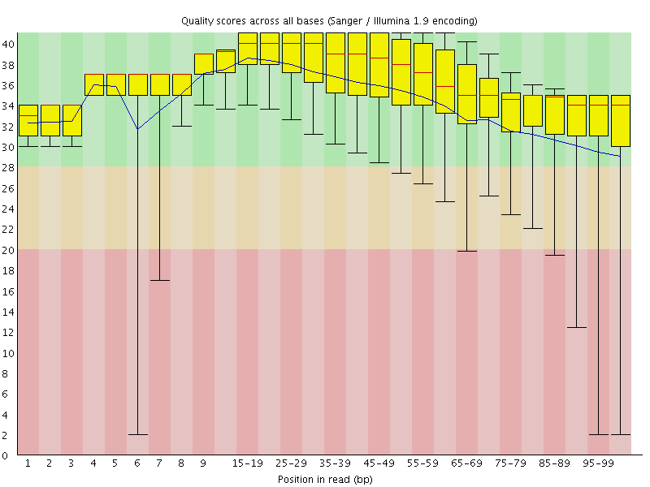
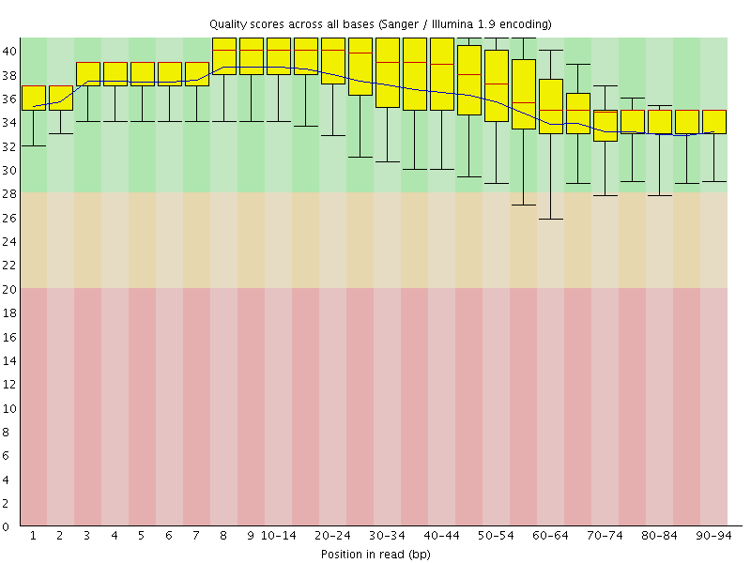
Transcriptome Analysis
Methods and Tools
Quality checks
Before quality trimming
After quality trimming

Slide 37
Transcriptome Analysis
Methods and Tools
Data alignment
We need to align the sequence data to our genome of interest
If aligning RNA-Seq data to the genome, always pick a slice-aware aligner
Genome
Alignment
Reads
Gene
Versus
Genome
Splice-Aware
Alignment
Reads
Gene

Slide 38
Transcriptome Analysis
Methods and Tools
Data alignment
We need to align the sequence data to our genome of interest
If aligning RNA-Seq data to the genome, always pick a slice-aware aligner
TopHat2, MapSplice, SOAPSplice, Passion, SpliceMap, RUM, ABMapper, CRAC, GSNAP, HMMSplicer, Olego, BLAT
There are excellent aligners available that are not splice-aware. These are useful for aligning directly to an already available transcriptome (gene models, so you are not worrying about introns). However, be aware that you will lose isoform information.
Bowtie2, BWA, Novoalign (not free), SOAPaligner

Slide 39
Transcriptome Analysis
Methods and Tools
Data alignment
What other considerations do you have to make when choosing an aligner?
How does it deal with reads that map to multiple locations?
How does it deal with paired-end versus single-end data?
How many mismatches will it allow between the genome and the reads?

Slide 40
Transcriptome Analysis
Methods and Tools
Data alignment
How does one pick from all the tools available?
Tophat is the most commonly used splice-aware aligner, and is part of a suite of software that make up the Tuxedo pipeline/suite. It is reliable.
Some of the listed tools are a little better than the others at doing specific things; e.g. better speed or memory usage, available options for reads that have multiple hits, and so on.

Slide 41
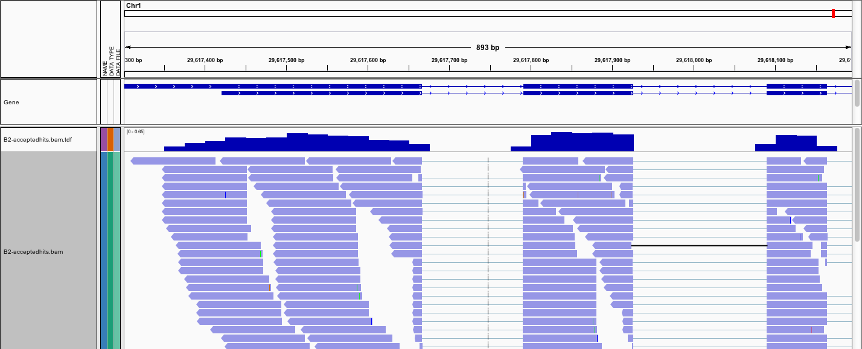
Transcriptome Analysis
Methods and Tools
Data alignment
IGV is the visualization tool used for this snapshot
Notes:
Differential gene expression

Slide 42
Outline
Transcriptomic analysis methods and tools
Transcriptome Analysis; aspects common to both assembly and differential gene expression
Quality check
Data alignment
Assembly
Differential Gene Expression
Choosing a method, the considerations…
Final thoughts and observations

Slide 43
Transcriptome Assembly overview
Methods and Tools
Obtain/download sequence data from sequencing center
Check quality of data and trim low quality bases from ends
Pick your method of choice for assembly
Reference-based assembly?
(Align to reference and assemble)
A de novo assembly?
Notes:
Differential gene expression

Slide 44
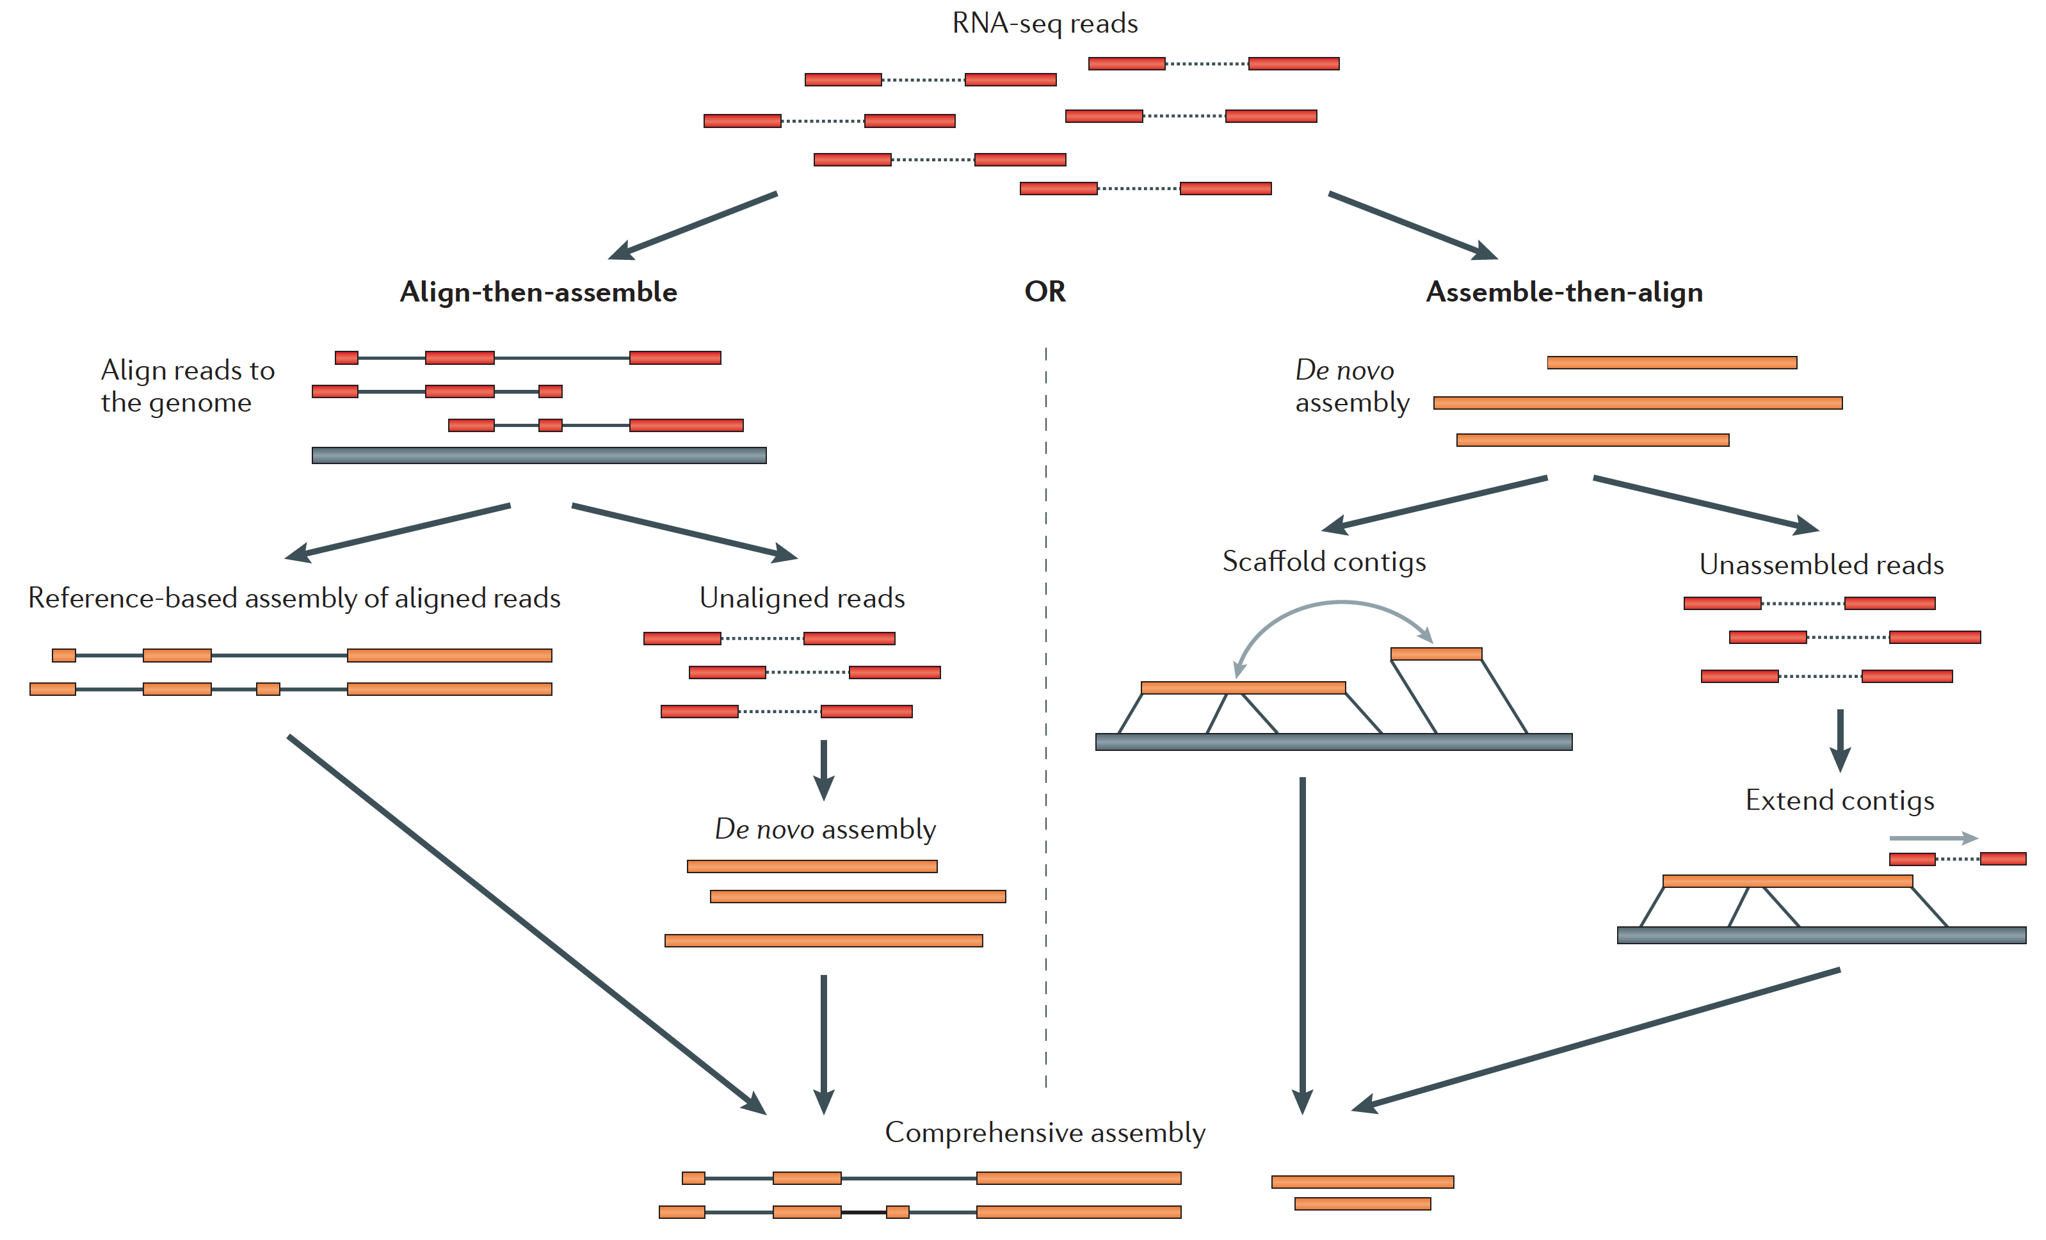
Transcriptome Assembly
Methods and Tools
Reference-based assembly
De novo assembly
Martin J.A. and Wang Z., Nat. Rev. Genet. (2011) 12:671–682
Notes:
Transcriptome assembly, de novo, reference-based
http://trinityrnaseq.sourceforge.net/

Slide 45
Transcriptome Assembly
Methods and Tools
Reference-based assembly
This type of assembly is used when the genome sequence is known.
Transcriptome data are not available
Transcriptome information available is not good enough, i.e. missing isoforms of genes, or unknown non-coding regions
The existing transcriptome information is for a different tissue type
Cufflinks and Scripture are two reference-based transcriptome assemblers
Notes:
Transcriptome assembly, de novo, reference-based
http://trinityrnaseq.sourceforge.net/

Slide 46
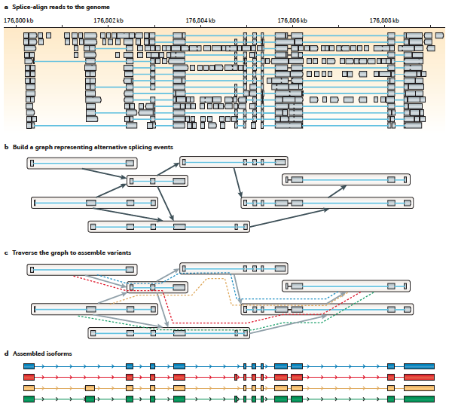
Transcriptome Assembly
Methods and Tools
Reference-based assembly
Martin J.A. and Wang Z., Nat. Rev. Genet. (2011) 12:671–682

Slide 47
Transcriptome Assembly
Methods and Tools
Reference-based assembly
Martin J.A. and Wang Z., Nat. Rev. Genet. (2011) 12:671–682

Slide 48
Transcriptome Assembly
Methods and Tools
Reference-based assembly
Martin J.A. and Wang Z., Nat. Rev. Genet. (2011) 12:671–682

Slide 49
Transcriptome Assembly
Methods and Tools
Reference-based assembly
Martin J.A. and Wang Z., Nat. Rev. Genet. (2011) 12:671–682

Slide 50
Transcriptome Assembly
Methods and Tools
De novo assembly
This type of assembly is used when very little information is available for the genome
An assembly of this type is often the first step in putting together information about an unknown genome
Amount of data needed for a good de novo assembly is higher than what is needed for a reference-based assembly
Assemblies of this sort can be used for genome annotation, once the genome is assembled
Oases, TransABySS, Trinity are examples of well-regarded transcriptome assemblers, especially Trinity
It is not uncommon to used both methods and compare and combine the assemblies, even when a genome sequence is known, especially for a new genome.
Notes:
Transcriptome assembly, de novo, reference-based
http://trinityrnaseq.sourceforge.net/

Slide 51
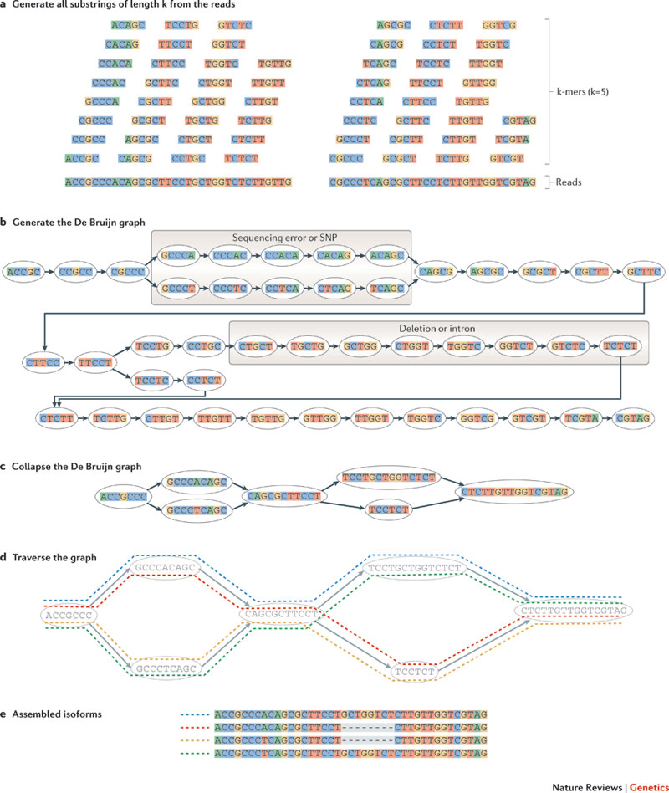
Transcriptome Assembly
Methods and Tools
De novo assembly (De Bruijn graph construction)
Martin J.A. and Wang Z., Nat. Rev. Genet. (2011) 12:671–682

Slide 52
Transcriptome Assembly
Methods and Tools
De novo assembly (De Bruijn graph construction)
Martin J.A. and Wang Z., Nat. Rev. Genet. (2011) 12:671–682

Slide 53
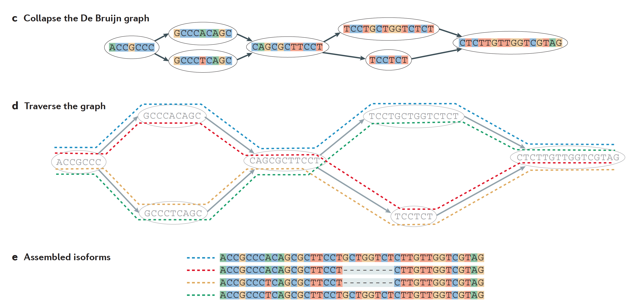
Transcriptome Assembly
Methods and Tools
De novo assembly (De Bruijn graph construction)
Martin J.A. and Wang Z., Nat. Rev. Genet. (2011) 12:671–682

Slide 54
Outline
Transcriptomic analysis methods and tools
Transcriptome Analysis; aspects common to both assembly and differential gene expression
Quality check
Data alignment
Assembly
Differential Gene Expression
Choosing a method, the considerations…
Final thoughts and observations

Slide 55
Differential Gene Expression overview
Methods and Tools
Obtain/download sequence data from sequencing center
Check quality of data and trim low quality bases from ends
Align trimmed reads to genome of interest
Pick alignment tool, splice-aware or not? (map to gene set?)
Index genome file according to instructions for that tool
Run alignment after choosing the relevant parameters, like how many mismatches to allow between reads and genome? what is to be done with reads that map to multiple locations?
Notes:
Differential gene expression

Slide 56
Differential Gene Expression overview
Methods and Tools
Set up to do differential gene expression
Identify read counts associated with genes using the gene annotation file
Make sure that your genome information and gene annotation information match (release numbers and chromosome names)
Do you want to obtain raw read counts or normalized read counts? This will depend on the statistical analysis you wish to perform downstream.
htseq will take an alignment file and a gene annotation file to give you read counts associated with each gene
Cufflinks will take the same information as htseq and give you FPKM normalized counts for each gene
Notes:
Differential gene expression

Slide 57
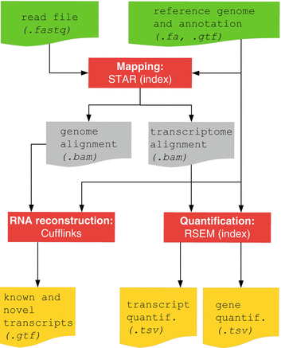
Differential Gene Expression
Methods and Tools
Bowtie and Bowtie2 use Burrows-Wheeler indexing for aligning reads. With bowtie2 there is no upper limit on the read length
Bowtie2
Bowtie2 to align reads in a splice-aware manner and aids the discovery of new splice junctions
RSEM is a software package for estimating gene and isoform expression levels from RNA-Seq data. The RSEM package provides an user-friendly interface, supports threads for parallel computation of the EM algorithm, single-end and paired-end read data, quality scores, variable-length reads and RSPD estimation.

Slide 58
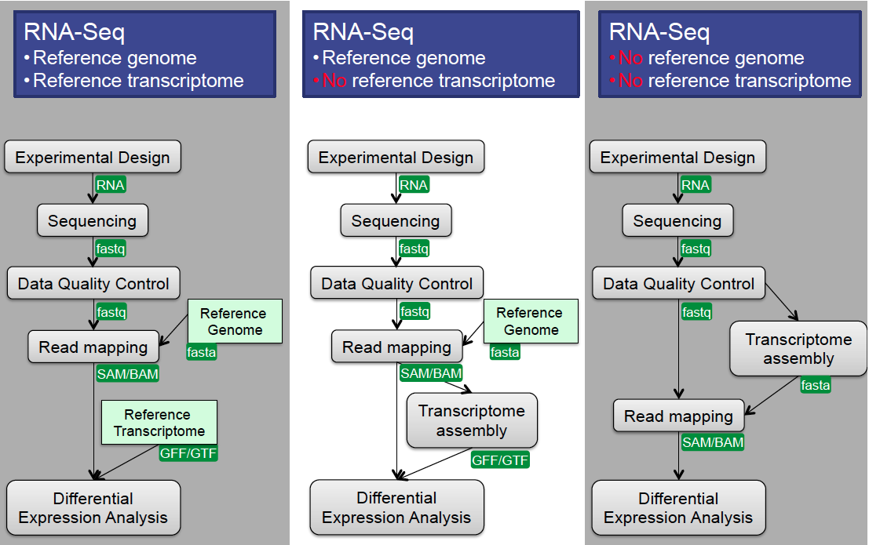
Differential Gene Expression
Methods and Tools
Options for DGE analysis

Slide 59
Differential Gene Expression
Methods and Tools
Options for DGE analysis

Slide 60
Differential Gene Expression
Methods and Tools
Options for DGE analysis

Slide 61
Differential Gene Expression
Methods and Tools
Differential Gene Expression
What genes are being differentially expression in the various test conditions
The first step is proper normalization of the data, several methods exist, and often the statistical package you use (see below) will have a normalization method that it prefers and uses exclusively. E.g. Voom, FPKM, scaling (used by EdgeR)
Is your experiment a pairwise comparison? Tools -> Cuffdiff, EdgeR, DESeq
Is it a more complex design? Tools -> EdgeR, DESeq, other R/Bioconductor packages
In general, RNA-Seq data do not follow a normal (Poisson) distribution, but follow a negative binomial distribution. Use a statistical program that makes the correct assumptions about the data distribution.

Slide 62
Outline
Transcriptomic analysis methods and tools
Transcriptome Analysis; aspects common to both assembly and differential gene expression
Quality check
Data alignment
Assembly
Differential Gene Expression
Choosing a method, the considerations…
Final thoughts and observations

Slide 63
Transcriptome Analysis
Methods and Tools
How does one pick the right tool?

Slide 64
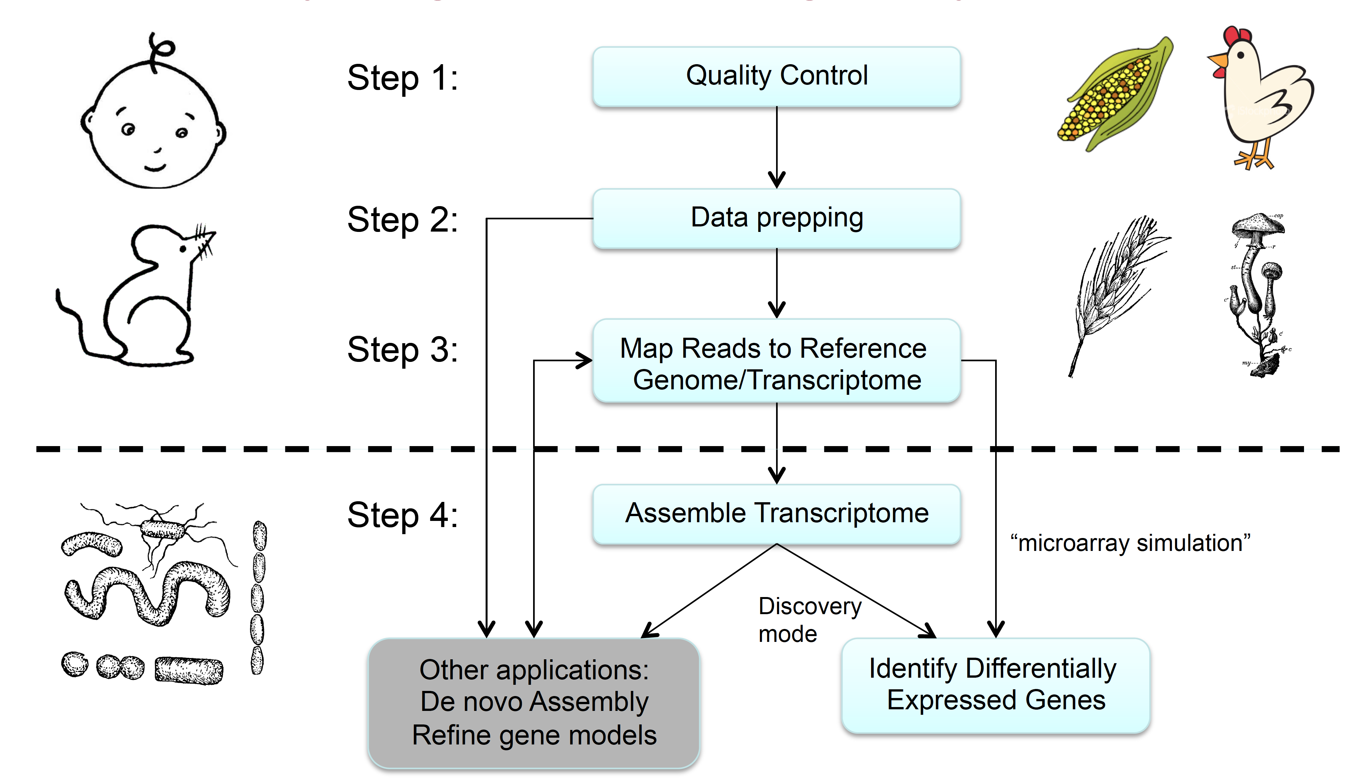
University of Minnesota, Research Informatics Support System (RISS) group

Slide 65
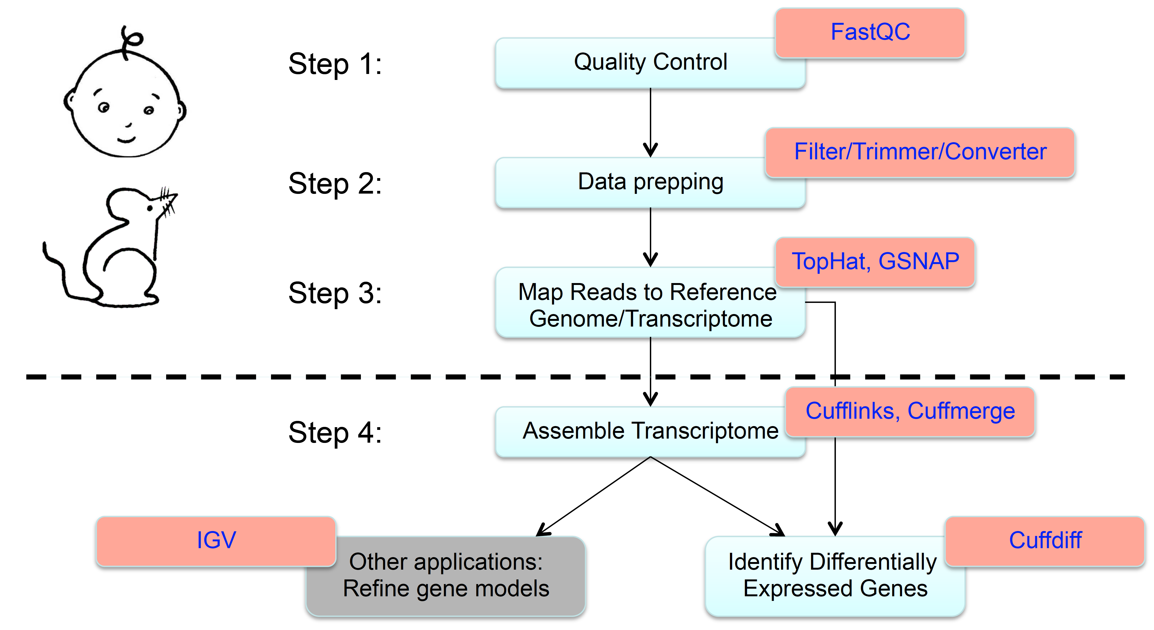
University of Minnesota, Research Informatics Support System (RISS) group

Slide 66
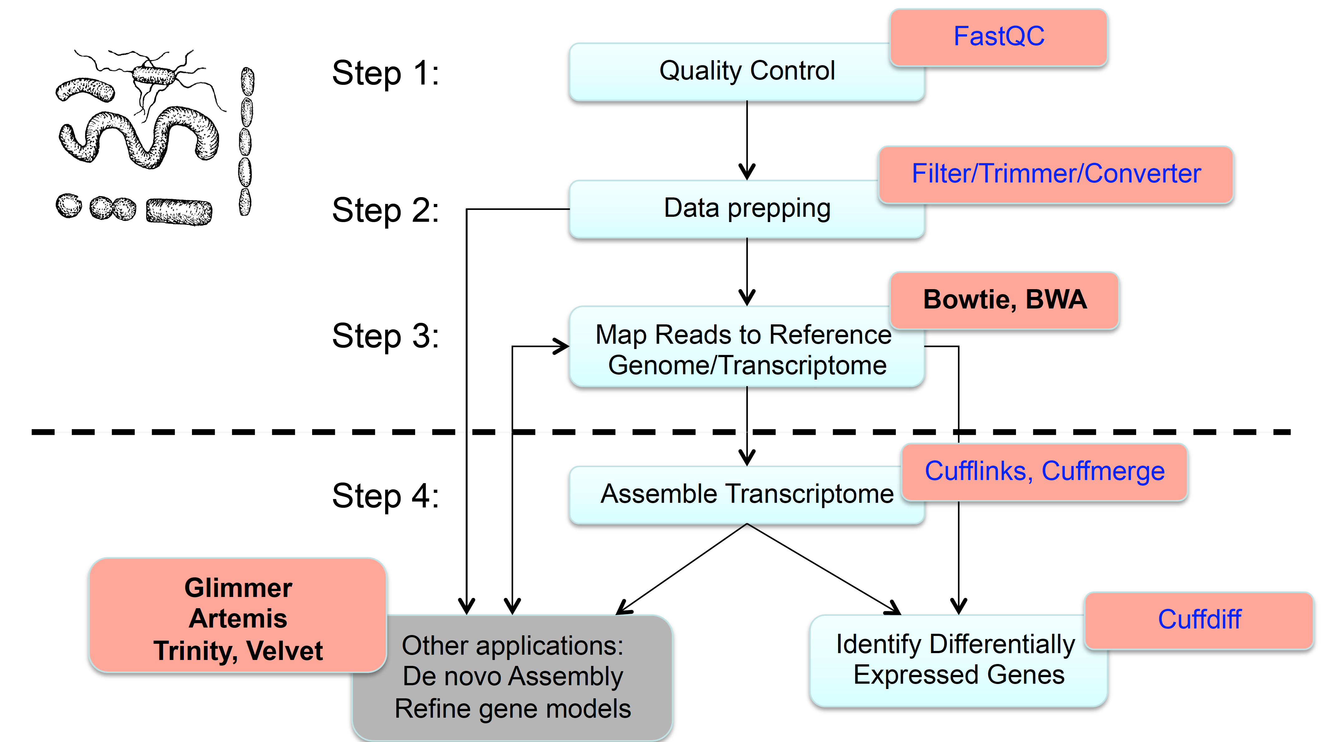
“We don’t recommend assembling bacteria transcripts using Cufflinks at first. If you are working on a new bacteria genome, consider a computational gene finding application such as Glimmer.” – Cufflinks developer
University of Minnesota, Research Informatics Support System (RISS) group

Slide 67
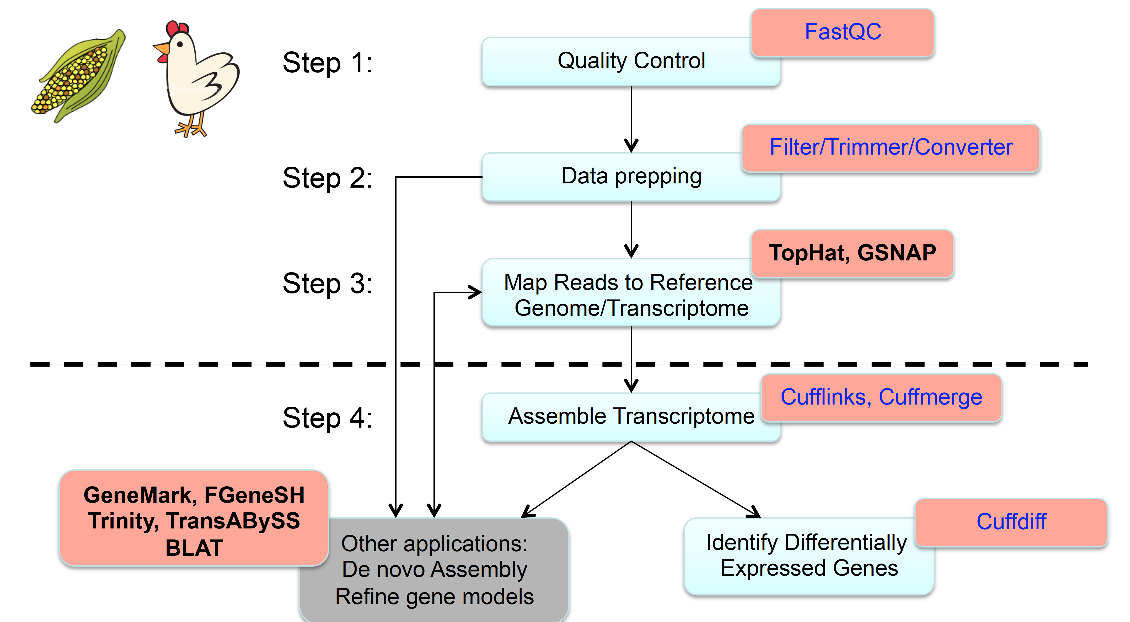
University of Minnesota, Research Informatics Support System (RISS) group

Slide 68
Outline
Transcriptomic analysis methods and tools
Transcriptome Analysis; aspects common to both assembly and differential gene expression
Quality check
Data alignment
Assembly
Differential Gene Expression
Choosing a method, the considerations…
Final thoughts and observations

Slide 69
Topics covered today
Getting the RNA-Seq data: from RNA -> Sequence data
Experimental and Practical considerations
Transcriptomic analysis methods and tools
Assemblies
Differential Gene expression

Slide 70
Final thoughts and stray observations
Think carefully about what your experimental goals are before designing your experiment and choosing your bioinformatics tools

Slide 71
Final thoughts and stray observations
Think carefully about what your experimental goals are before designing your experiment and choosing your bioinformatics tools
When in doubt “Google it” and ask questions.
http://www.biostars.org/ - Biostar (Bioinformatics explained)
http://seqanswers.com/ - SEQanswers (the next generation sequencing community)
These sites cover a variety of topics, and questions from people with a variety of expertise. If you know what you are looking for, it is very likely that someone has already asked the question. If not, it is good forum to ask it yourself.

Slide 72
Final thoughts and stray observations
Think carefully about what your experimental goals are before designing your experiment and choosing your bioinformatics tools
When in doubt “Google it” and ask questions.
http://www.biostars.org/ - Biostar (Bioinformatics explained)
http://seqanswers.com/ - SEQanswers (the next generation sequencing community)
These sites cover a variety of topics, and questions from people with a variety of expertise. If you know what you are looking for, it is very likely that someone has already asked the question. If not, it is good forum to ask it yourself.
Another good resource if you are not ready to use the command line routinely is Galaxy. It is a web-based bioinformatics portal that can be locally installed, if you have the necessary computational infrastructure.

Slide 73
Final thoughts and stray observations
Today we covered how to deal with Illumina data, but not other types of sequence data. Usually you are going to encounter short-read Illumina data for these types of analyses, but it is not uncommon for people to use 454 data as well. Hybrid assemblies can be done, but are challenging and no straightforward method exists.

Slide 74
Final thoughts and stray observations
Today we covered how to deal with Illumina data, but not other types of sequence data. Usually you are going to encounter short-read Illumina data for these types of analyses, but it is not uncommon for people to use 454 data as well. Hybrid assemblies can be done, but are challenging and no straightforward method exists.
For evaluating de novo transcriptome assemblies, you can compare the new genes to closely related species or evolutionarily conserved genes and check for representation (CEGMA, BUSCO).

Slide 75
Final thoughts and stray observations
Today we covered how to deal with Illumina data, but not other types of sequence data. Usually you are going to encounter short-read Illumina data for these types of analyses, but it is not uncommon for people to use 454 data as well. Hybrid assemblies can be done, but are challenging and no straightforward method exists.
For evaluating de novo transcriptome assemblies, you can compare the new genes to closely related species or evolutionarily conserved genes and check for representation (CEGMA, BUSCO).
R is an excellent language to learn, if you are interested in performing in-depth statistical analyses for differential gene expression analysis. (Not within the scope of this lecture/lab section.)

Slide 76
Documentation and Support
Online resources for RNA-Seq analysis questions –
http://www.biostars.org/ - Biostar (Bioinformatics explained)
http://seqanswers.com/ - SEQanswers (the next generation sequencing community)
Most tools have a dedicated lists
Contact us at:
hpcbiohelp@illinois.edu
hpcbiotraining@igb.illinois.edu
rkhetani@illinois.edu
Notes:
Thanks

Slide 77
Thank you for your attention!
For this presentation, figures and slides came from publications, web pages and presentations, and I am grateful for all the help.
Notes:
Thanks

